Slide 1
IT1762
Data Structures & Algorithms
Topic 2A
1 Dimensional Arrays

Slide 2
Topics
Array Declaration & Initialisation
Accessing data in arrays
Objectives:
Be able to declare, create and initialize one-dimensional arrays.
Be able to store and retrieve data items inside arrays.

Slide 3
What is an Array ?
An array is a collection of elements of the same data type.
Recall what is a variable:
int age = 42;
An array is like many variables joined together to form a group or collection of variables.
An array can only store the same type of data ie. all integers or all float. You cannot have different type of data in the same array ie. integer and float together.
42
age
21
33
5
66
An array of integers

Slide 4
How to Create an Array
The syntax for an array declaration:
  data_type [ ] arrayName;
where:
data_type – data type of the array elements eg. int, float, char, string etc..
[ ] – indicates a One Dimension array
arrayName – name of array, rules follow after that of variables. Up to programmer.
Examples:
int [ ] pizza;
string [ ] nickNames;
  Arrays are objects in C#. We will only discuss objects in detail next semester.
To create elements in an array, we will assume the following syntax:
Example:
int [ ] age={18,17,18,19,17};
Create and initialize the array with values

Slide 5
Array Declaration
Example:
age
static void Main( )
{
int [] age={18,17,17,19};
}
[18]
age[0]
[17]
age[1]
Elements of array
[17]
age[2]
Variable name
[19]
age[3]
Data type
Data type of array is integer
The array name is age
The array has 4 elements/items
The array is accessed thru its index starting from 0.

Slide 6
Array Initialisation
We could create an array and set all the values of an array
We declare it like this:
//array of 4 float elements
float [] interest =
{8.0f,6.5f,5.2F,10.0F};
//array of 2 long elements
long [] acctno =
{885657410211L,787852526336l};
//array of 7 string elements
string [] acctname =
{“”, “”, “”, “”, “”, “”, “”};

Slide 7
Exercise
Create and initialize an array with “apple”, “orange”, “pear”.
Create and initialize an array with 33.3, 44.4, 55.5.
Create and initialize an array with “jack”, 33, “pie”, 22
string [ ] fruits = { “apple”, “orange”, “pear”};
double [ ] weight = { 33.3, 44.4, 55.5 };
Not possible!! An array can only store values of the SAME data type.

Slide 8
The Array Index or Subscript
int [ ] marks = { 20, 33, 15, 29 };
marks
20 | 33 | 15 | 29
0 1 2 3
Array Index or Subscript:
Always start with zero
Last value is Array Size - 1
Use the Index or Subscript to STORE or GET data from individual element or box.
Example:
marks[ 2 ] = 99;
Getting individual marks out:
int temp = marks[ 0 ];
MessageBox.Show (“Last mark is “ + mark[ 3 ]);
will store 99 into the 3rd element or box.
It displays 29

Slide 9
Getting data from Arrays
//Array of 3 integer numbers and initialise it
int [] numbers= {1,2,3};
MessageBox.Show(“1st number:“ + numbers[0]);
MessageBox.Show(“2nd number:“ + numbers[1]);
MessageBox.Show(“3rd number:“ + numbers[2]);
OUTPUT
1st number:1
2nd number:2
3rd number:3
1
2
3
??
numbers [0]
numbers [1]
numbers [2]
? numbers[3]
What will happen if we try to print numbers[3] ?
    MessageBox.Show(“4th number:“ + numbers[3]);

Slide 10
Storing Data in Arrays
//Array of 3 integer numbers
int [] numbers= {1,2,3};
// Assign 3 new numbers in array
numbers[0] = 10;
numbers[1] = 11;
numbers[2] = 12;
MessageBox.Show(“1st number:“ + numbers[0]);
MessageBox.Show(“2nd number:“ + numbers[1]);
MessageBox.Show(“3rd number:“ + numbers[2]);
What will be displayed in the message box?
numbers[0] means at index 0.
The number is 10.
When the array size grows to 100, how would you store the 100 numbers?

Slide 11
Spot the errors
Try out the following statements to see if they are valid or invalid.
int [] array1;
array1 = {0,2,4,6};
int [] array2;
MessageBox.Show( “value is “ + array2[0] );
double [] arrayA={1.0,1.6};
MessageBox.Show(arrayA[2]);
double [] arrayB={1.0,1.6};
arrayB[2] = 1.8;
arrayB[3] = 1.75;

Slide 12
Creating Empty Arrays using keyword - NEW
Here is another way to create Array
  Arrays in C# are objects and reference type (these concepts shall be covered later).
To create an empty Array, use the following syntax:
data_type [ ] array_name = new data_type[ size ];
where:
data_type : int, float, double, string etc.. etc..
array_name : any variable name
size : positive integer value
Example:
int [ ] ages = new int[ 10 ];
Create an array, ages with 10 integers of zeros.
It is the same as:
int [] ages = {0,0,0,0,0 0,0,0,0,0}
but it saves the coding effort to define the initial values.
What happened if you would need an array of size 1000?

Slide 13
Creating an Empty Array
int [ ] age;
This just declares an Array variable age. It does not create any Array instance.
int [ ] age = new int[ 4 ];
Using new keyword to create empty array
age
Specify the size to create the actual array instances (elements). E.g 4
0
0
0
0
age
You can use one or two statements:
int [ ] age;
age = new int[5];
int [ ] age = new int[5];

Slide 14
Creating an Empty Array
C# automatically fills empty arrays with default values:
  integer array initialise with 0
  floating-point array intialise with 0.0
  boolean array initialise with false
  string array initialise with null values
C# arrays are Reference Type
  example:
  int [ ] marks = new int[ 4 ];
0
0
0
0
marks
However, it is a good practice to initialise array with zero or null values as other programming languages may not have this feature of setting it to zero.

Slide 15
Initialise an Array
  Create an empty array with length explicitly given
  int [ ] Marks = new int[ 4 ];
  // initialise the array using indexing, one by one
  Marks[0] = 23;
  Marks[1] = 33;
  Marks[2] = 43;
  Marks[3] = 53;
Or the equivalent
Create and initialise it explicitly with No length given
  int [ ] Marks = {23, 33, 43, 53};

Slide 16

Summary – What is Array?
int [] SilverSea= {0,0,0};
Or int [] SilverSea = new int [3];
SilverSea
15 is the person staying in the unit [0]
SilverSea[0] = 15

Slide 17
Summary
  How to declare an array
  How to initialise an array
  How to create an empty array
  How to access an array’s elements by using the index to:
    obtain data
    store data

Slide 18
Summary - 1D Array
Create
int [] age = {11,22,33}
int [] age = new int [3]
Access
Index / position, starts from 0
Store
age [0] = 22
Using index
age [0] is the content at first location
1D array

Slide 19
Practical 2A
Write C# statements to create and intialize the arrays below:
an array of age containing these integers - 11, 22, 31, 44.
an array of height containing these values - 1.32, 1.40, 1.55, 2.0, 1.8
(c) an array of names containing these strings – Alex Foley, Jane Smith, Louis Vuitton, Jack Seah

Slide 20
Practical 2A
Write the C# statements to create empty arrays (using New keyword) for the following cases. You can define your own array names.
10 integer values to capture Marks. Set the 1st mark as 80
12 float values to capture Sales. Set the 10th value as 900.99
6 string values to capture Months. Set the last month as “June”

Slide 21
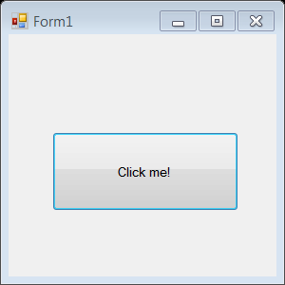
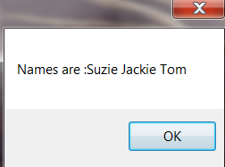
Practical 2A
Create a window application to perform the following tasks when user clicks “Click Me” button:
  Create a string array named Friends with 3 elements using the “new” keyword.
  Assign each array element with the following names – Suzie, Jackie, Tom (use array subscript or index)
  Print out all the names using the array subscript or index. Hint using MessageBox. Show ()
Complete the program in the BtnClickme_Click method.
private void BtnClickme_Click(object sender, EventArgs e)
{
}

Slide 22
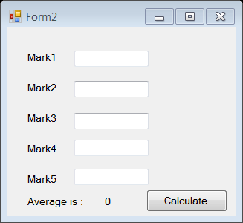
Practical 2A
A class can take up to 5 students. Write a C# window application program, when user clicks Calculate button, it captures the marks of the 5 students (e.g 75) and Calculates the average mark. Use array subscript or index (no looping).
Create the GUI form as in the figure.

Slide 23
Practical 2A
Complete the program in the BtnCalculate method provided.
Test your result in the window application you have created.
private void BtnCalculate_Click(object sender, EventArgs e)
{
// create array using New keyword
int [] Mark = _______ int [ ______ ];
int total;
float average;
// store 5 marks;
Mark[ ____ ] = int.Parse( txtMark1.Text );
Mark[ ____ ] = int.Parse( txtMark2.Text );
Mark[ ____ ] = int.Parse( txtMark3.Text );
Mark[ ____ ] = int.Parse( txtMark4.Text );
Mark[ ____ ] = int.Parse( txtMark5.Text );
total= Mark[__] + ____________________________________
average = total / __________;
lblAverage.Text = average. ToString();
}

Slide 24
Practical 2A
Bonus!
Set a breakpoint and debug your completed code in
Question 4.
Watch the Mark array, total and average variable. Record your observations.
  What are the initial values (default values) of Mark array?
  What is the purpose of index in array?
  How to compute the total and average values?
  What will happen if I create the array of size 3? (e.g int[] Mark = new int [3]) Will the program work?
  What happen if we were to have 100 mark records?
  Suggest ways to improve the program.

Slide 25
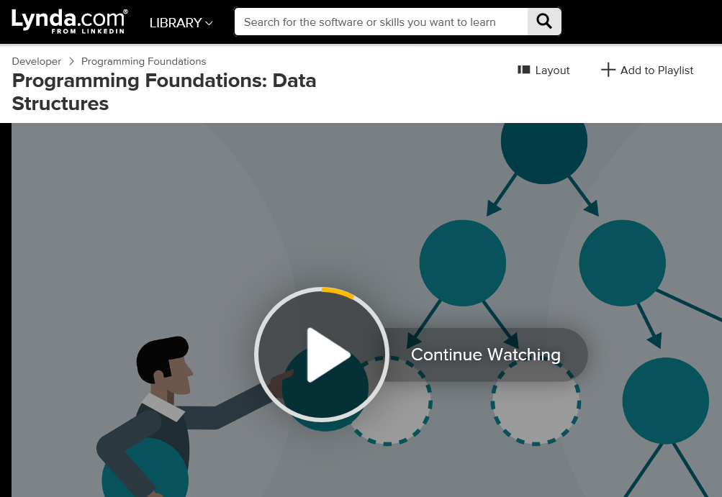
Extras elearning:
Differential Learning
Visit Lynda.com site
Watch Course: Programming Foundations: Data Structures
Topic: 1. Simple Structures and Basic Array ( 30mins )
  It provides an insight of the unique function of arrays

Slide 26
IT1762
Data Structures & Algorithms
End of Topic 2A
1 Dimensional Arrays

